Slide 1
Healthy Digital Habits
Fall Semester Final Update
Developers
Cody Bergman, Isaac Eberhard, Trevor Lemert, Ethan Byers, Tyler Likens
Faculty Advisor
Dr. MD Romael Haque
Project Sponsors
Dr. Brandon McDaniel and Dr. Jessica Pater

Slide 2
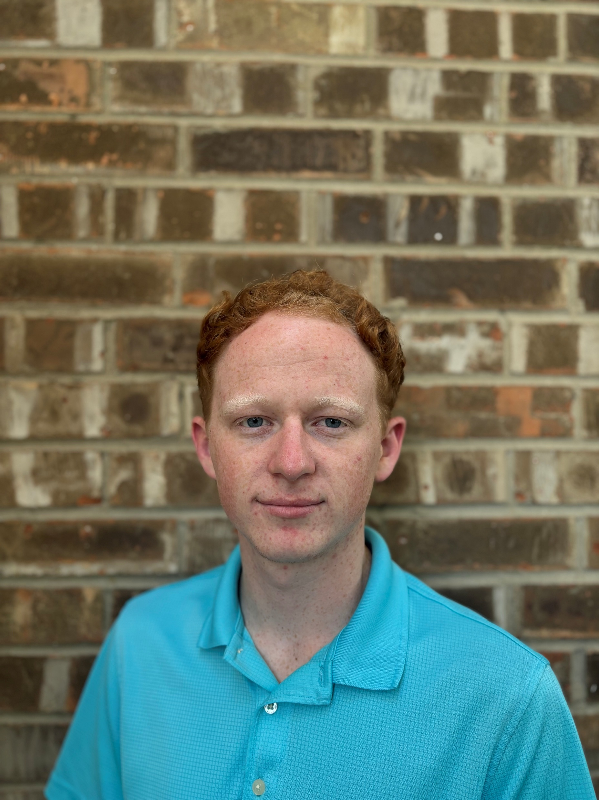
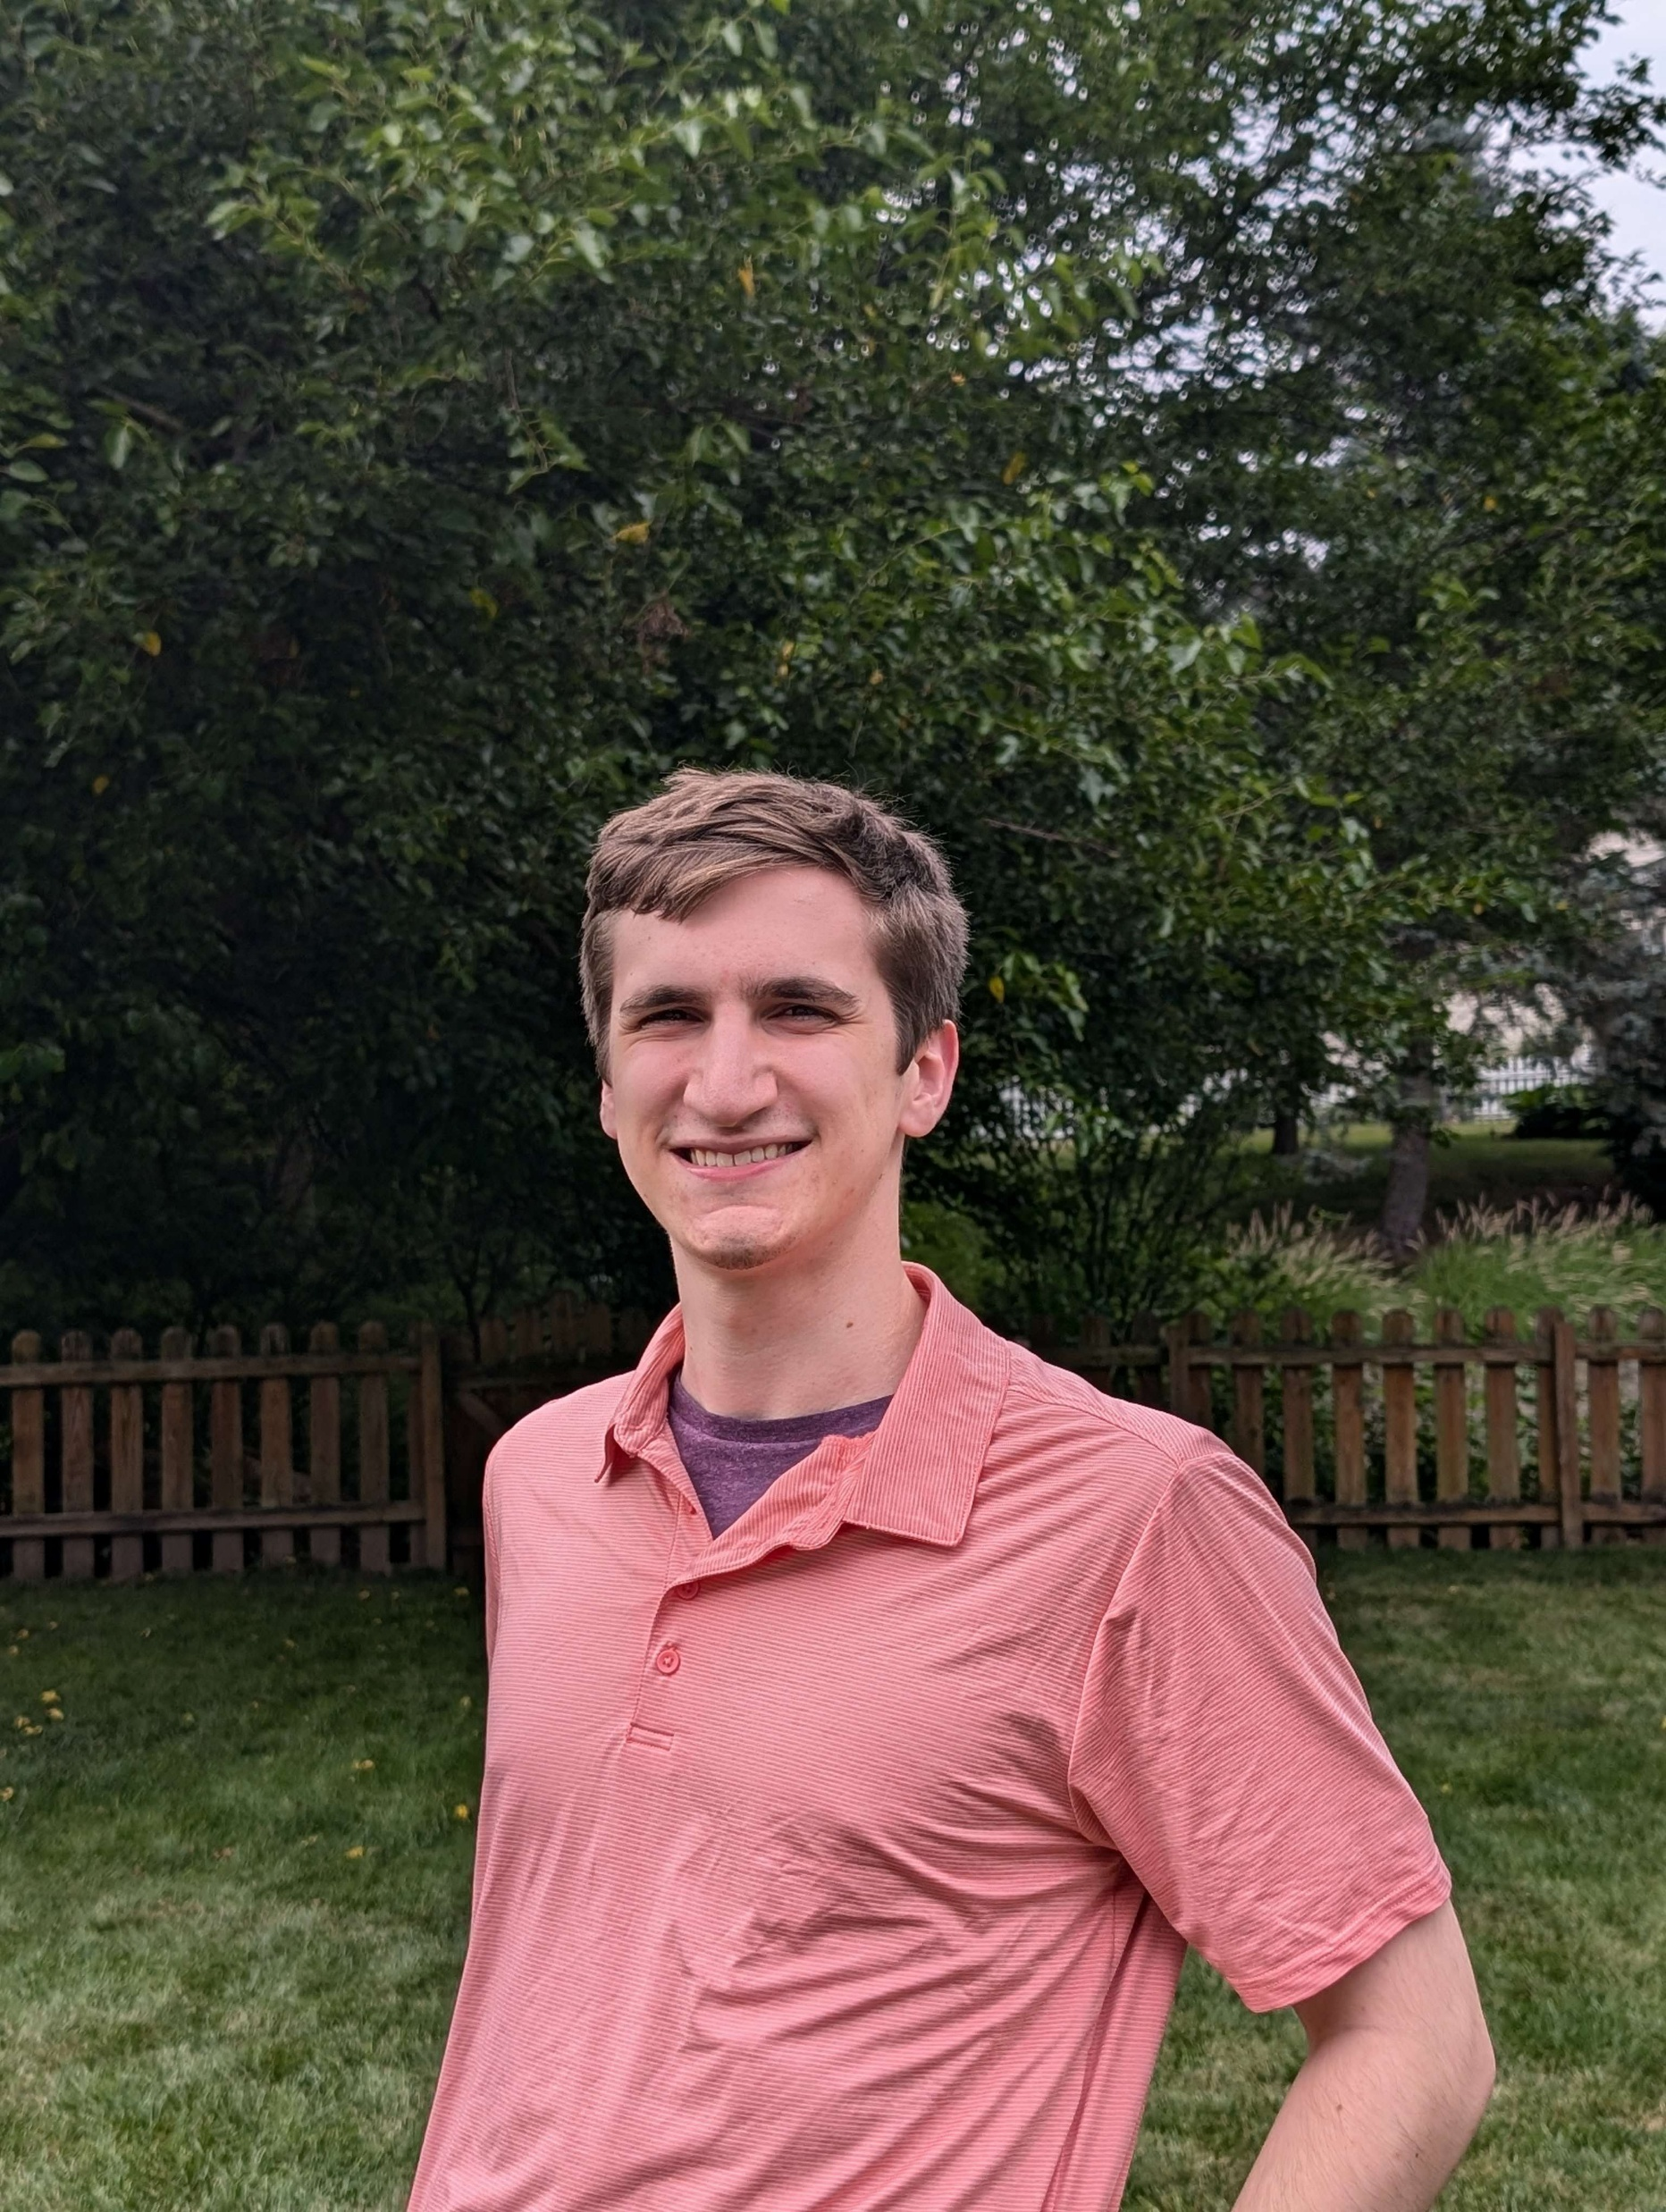
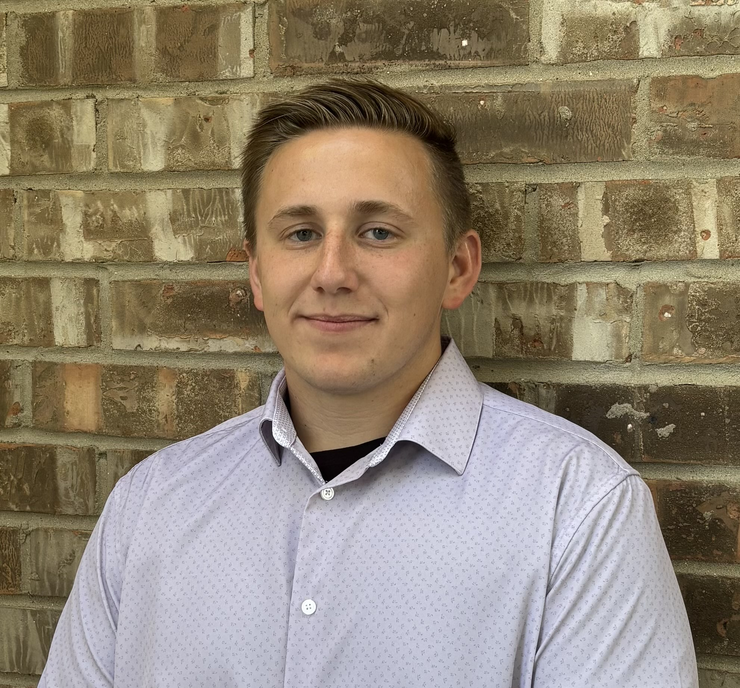
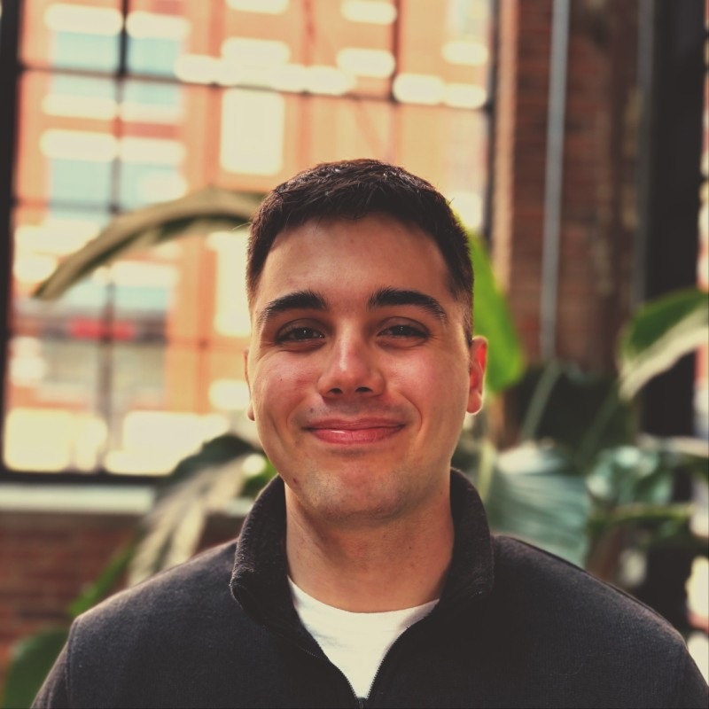
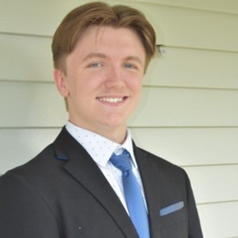
Meet the Team
Trevor Lemert
Backend / QA Tester
Ethan Byers
Front-end
Design / Development
Isaac Eberhard
Team Lead / Full Stack
Cody Bergman
Full stack / QA Tester
Tyler Likens
Full stack

Slide 3
Problem Statement
The Goal of the Project:
Develop a web application to help Parkview researchers better understand the relationship between smartphone use and family dynamics
Our Objective:
Implement missing functionality to give researchers the tools they need to create lesson plans
Overhaul UI for a more intuitive user experience

Slide 4
Project Background
Dr. Brandon McDaniel & team conducted study
Found that heavy smartphone usage negatively impacts household dynamics
Create a learning platform
Similar to online learning services like SkillShare and Coursera
Researchers collect feedback from clients (parents)
Lesson plans can be tailored to new developments
Teach healthier digital habits

Slide 5
Requirements
Functional
Admin view
Course creation tools (add, delete, edit, preview)
Support for various media types and content formats
Parent view
Ability to view on mobile device
Improved visuals and user feedback loops
Site wide
UI updates
V2 bug fixes
Non-Functional
WCAG 2.2 A Compliance
Mobile-friendly parent view
Bug fixes from V2
Scalable and ready for hosting (AWS, GCP, Azure)

Slide 6
Project Development Plan
Beginning Development
Here and Now
Parent UI Implementation
Pre-Initiation Stage
We plan to continue polishing course creation according to sponsor needs. Rest and recharge over break.
Final
Here we formed our team, met with Dr. McDaniel, Dr. Pater, and Dr. Haque.
We started simple, working on the navbar and other similar styling changes.
Continue implementing parent view changes such as the dashboard and improving the course viewing experience
Deploying the project, final documentation, back wrap-up
August
September
October
November
December
January
February
March
April
Inception, Elaboration, Prototyping
Project Deployment
Course Creation
Parent UI
Worked heavily on documentation and prototyping, receiving feedback from sponsors
In November, we reached a major milestone which was getting course creation working.
Provide high fidelity prototypes to serve as a NorthStar for our parent view UI improvements
Continued implementation, shortening the backlog. Preparing project for cloud deployment

Slide 7

Parent Use Case
Admin Use Case
Complete Daily Surveys
View Unlocked Courses
View/Complete Course Material
View Contents from Mobile Device
Provide Feedback
View/Complete Courses
Check individual data
Register/Login
Create Courses
Edit Existing Courses
Delete Courses
View Pooled User Data/Trends
Edit User Permissions
Delete User Accounts

Slide 8
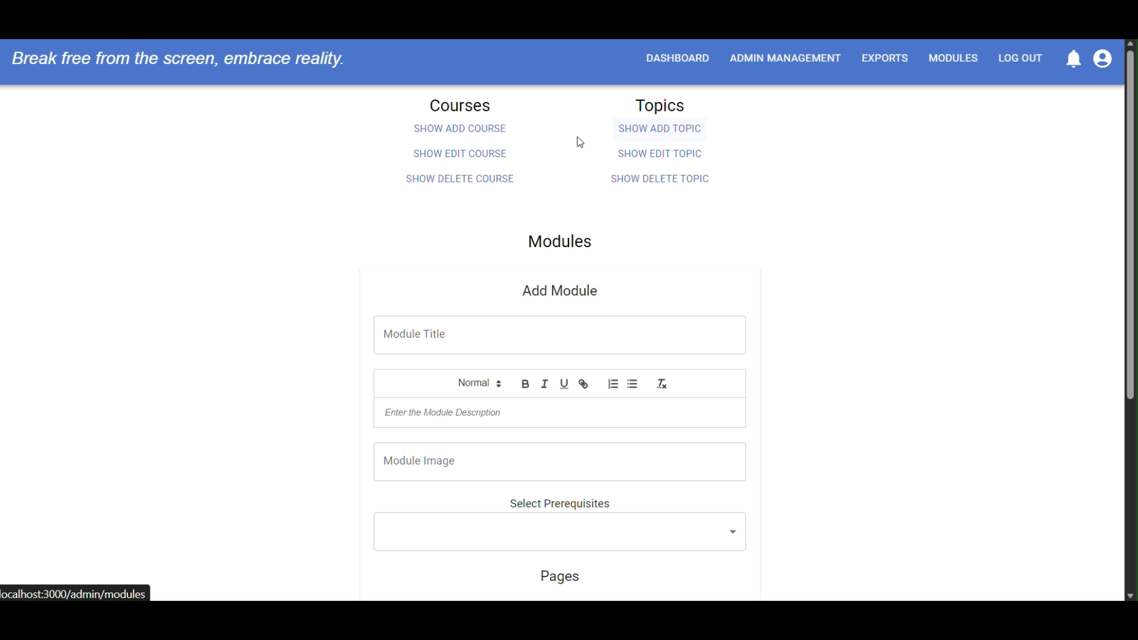
V2 Team Demonstration

Slide 9
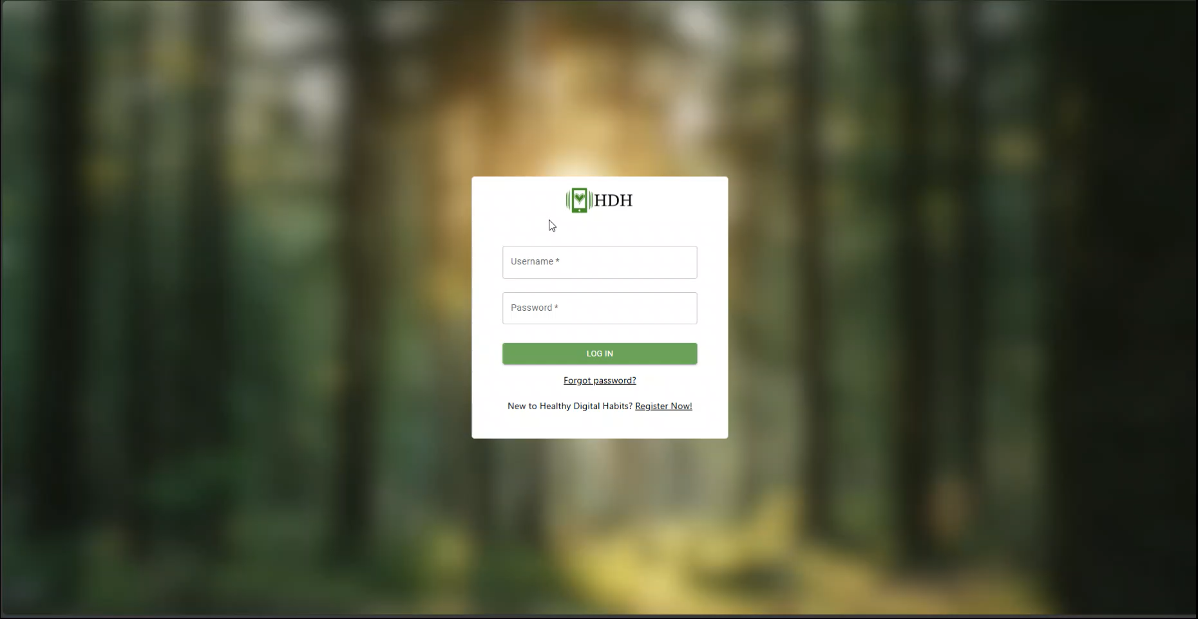
Demo

Slide 10
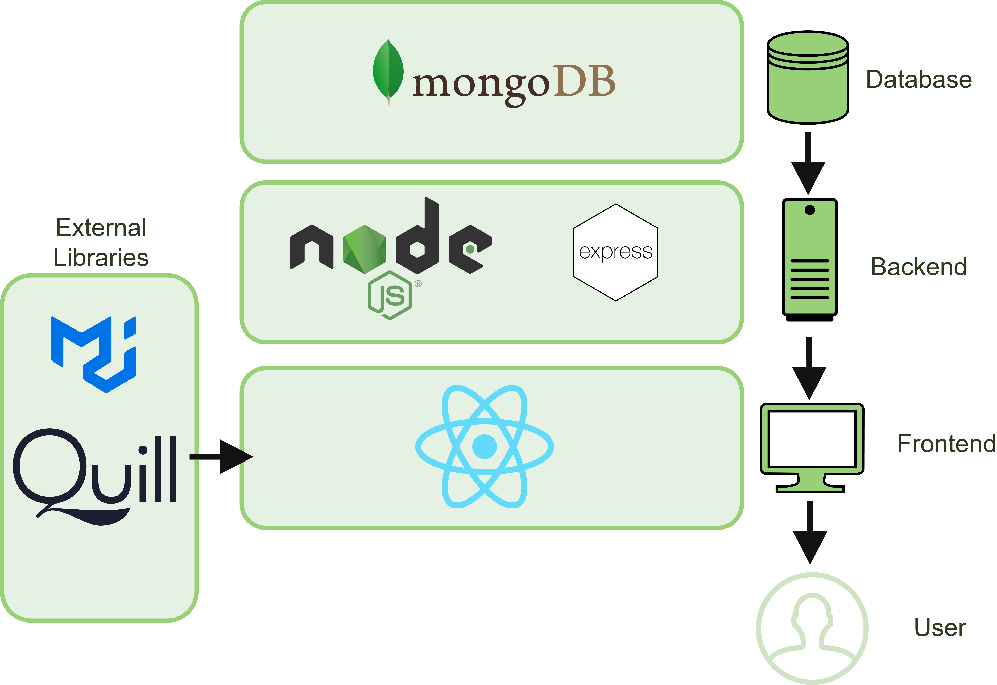
Technology Stack

Slide 11
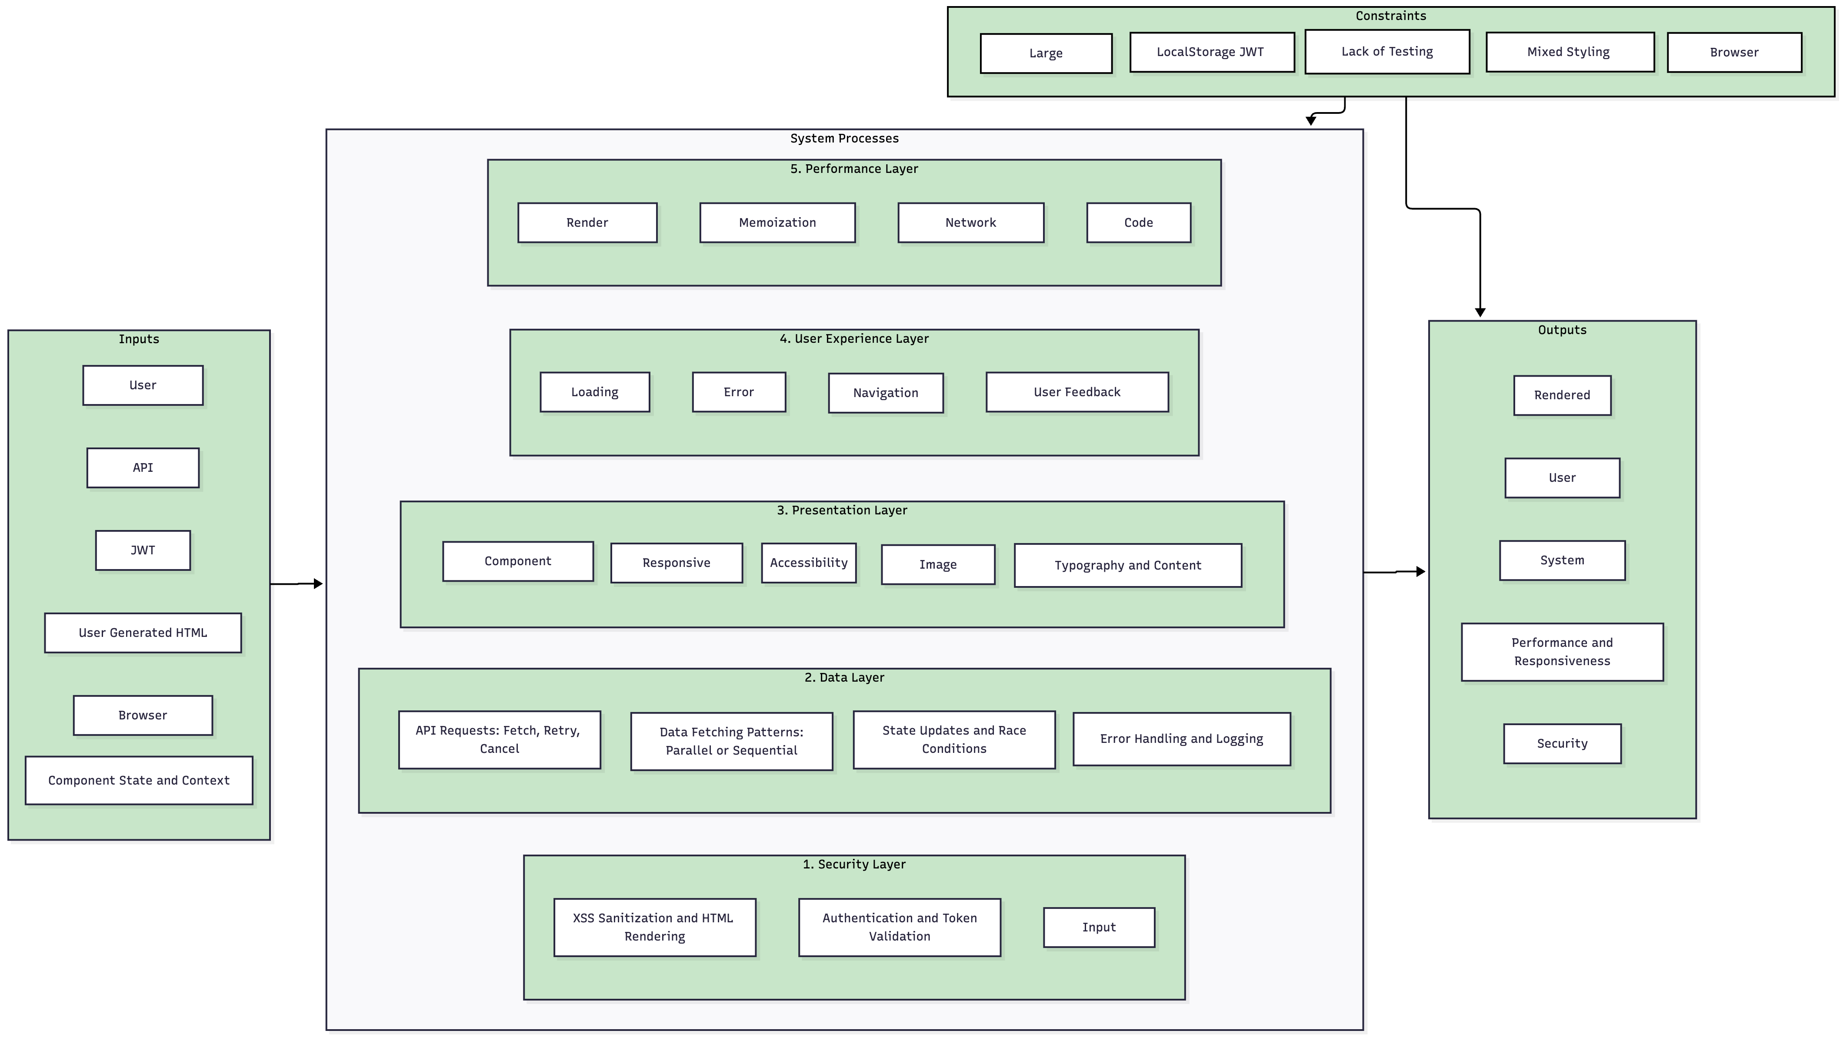
System Model

Slide 12
Challenges
UI Continuity
Cloud Hosting/ Deployment Issues
Changing Stakeholder Requirements
Data Security and Privacy
Technical Challenges with Previous Code

Slide 13

Q&A

